Slide 1
BIAS IN MOLECULAR EPIDEMIOLOGY
A story in three parts
Part III
Designing Defensible Inference
Public health molecular epidemiology
Justin Bahl
Notes:
Series title: Bias in Molecular Epidemiology: A story in three parts
Part III: Designing Defensible Inference

Slide 2
Purpose and learning objectives
Which design and analytical responses match the estimand, and where do those responses reach their limits?
Define the estimand before selecting genomes or analytical methods
Distinguish balanced, epidemic-informed, and probability-weighted selection
Separate repeated subsampling from analytical weighting and sensitivity analysis
Bound conclusions when target populations remain structurally absent
Part III Designing Defensible Inference
2
Notes:
Central question: Which design and analytical responses match the estimand, and where do those responses reach their limits?
Learning objectives:
- Define the estimand before selecting genomes or analytical methods
- Distinguish balanced, epidemic-informed, and probability-weighted selection
- Separate repeated subsampling from analytical weighting and sensitivity analysis
- Bound conclusions when target populations remain structurally absent

Slide 3
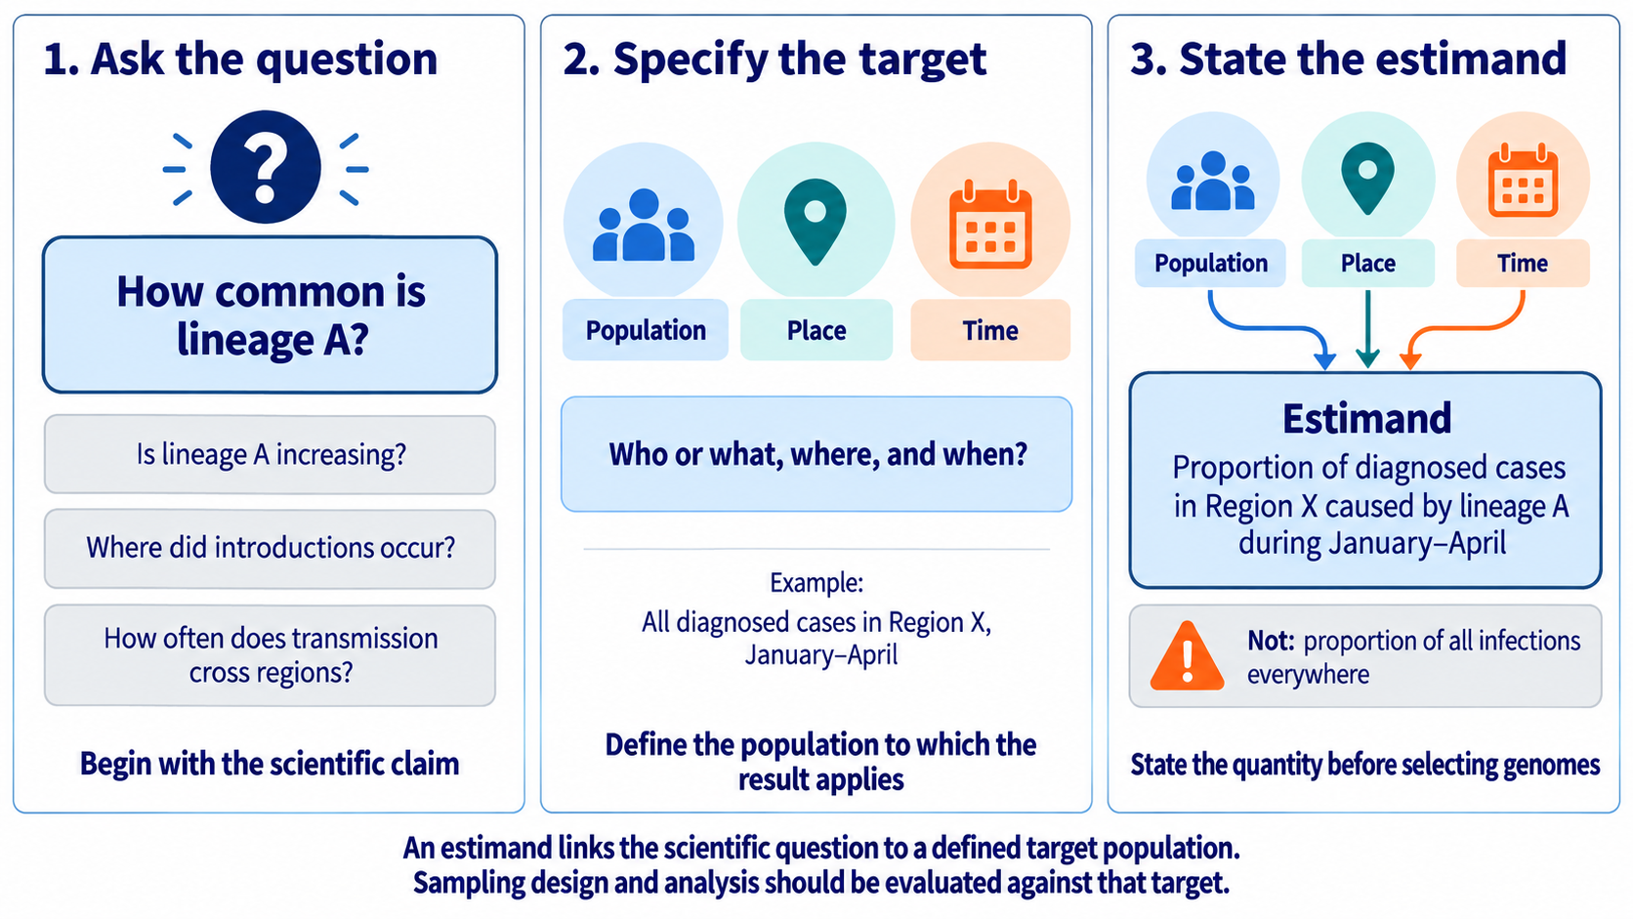
Figure 10A
Define the estimand
A sampling strategy cannot be evaluated until the target quantity is explicit.
Replace with Figure 10A illustration
Use the full illustration without adding competing slide text
4
Notes:
Teaching message: A sampling strategy cannot be evaluated until the target quantity is explicit.
Panel prompts:
- Start with the scientific question.
- Specify the target population, time, place, and quantity.
- State the estimand before choosing a design.

Slide 4
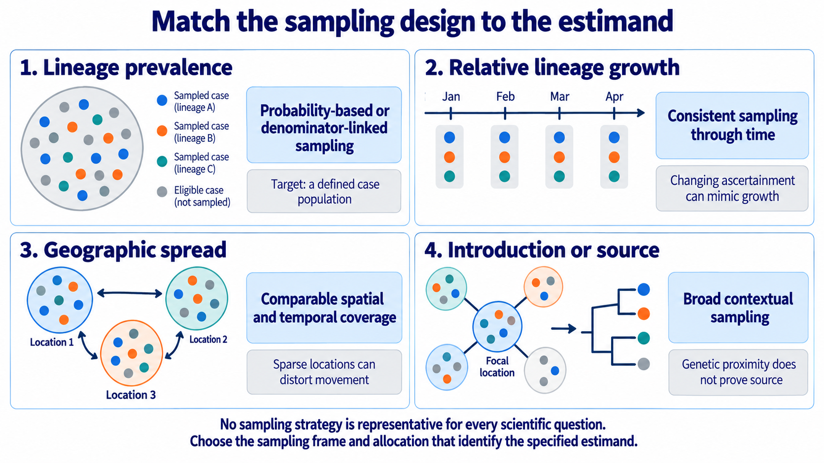
Figure 10B
Match the sampling design to the estimand
Lineage prevalence, relative growth, geographic spread, and source inference require different designs.
5
Notes:
Teaching message: Lineage prevalence, relative growth, geographic spread, and source inference require different designs.
Panel prompts:
- Compare the four scientific questions.
- Link each estimand to a defensible sampling structure.
- Make design mismatch visible.

Slide 5
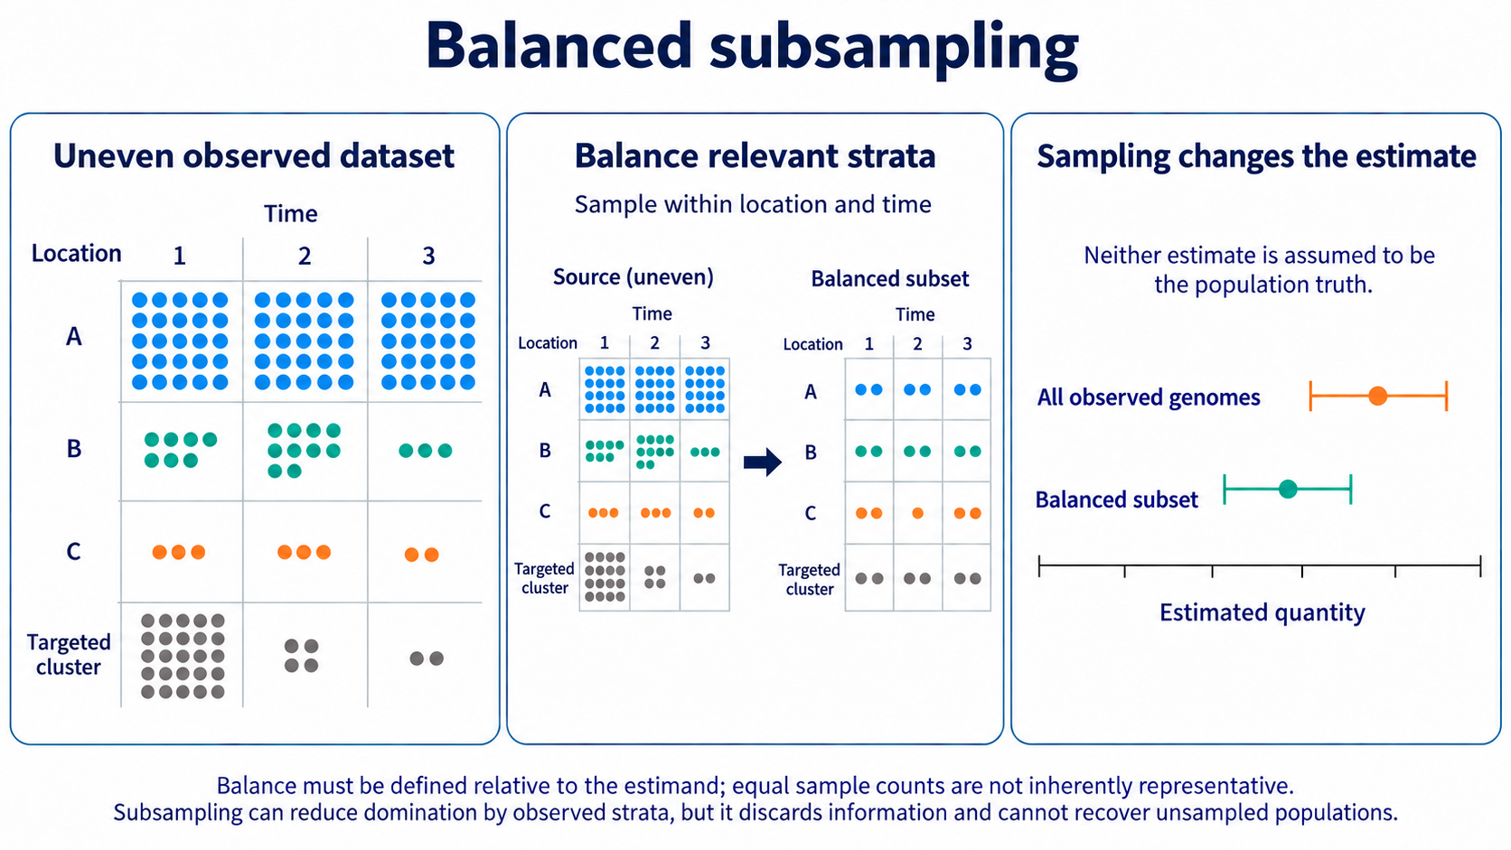
Figure 11
Balanced subsampling
Balancing observed strata can reduce domination but changes the represented distribution.
6
Notes:
Teaching message: Balancing observed strata can reduce domination but changes the represented distribution.
Panel prompts:
- Diagnose uneven location, time, and outbreak composition.
- Sample within prespecified strata relevant to the estimand.
- Treat neither estimate as population truth.

Slide 6
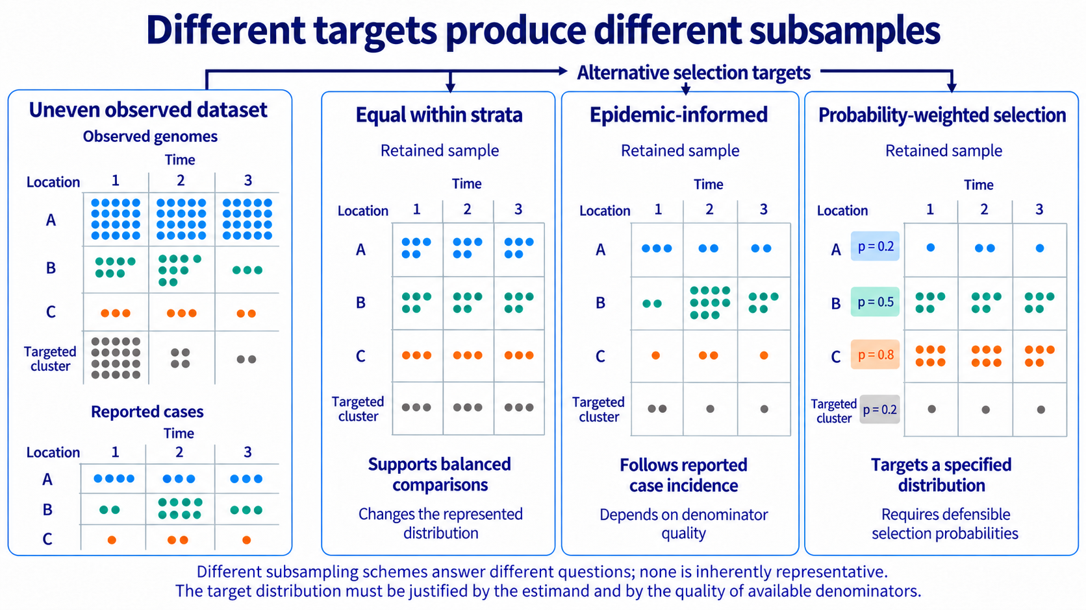
Figure 11B
Different targets produce different subsamples
Equal, epidemic-informed, and probability-weighted selection target different distributions.
7
Notes:
Teaching message: Equal, epidemic-informed, and probability-weighted selection target different distributions.
Panel prompts:
- Equal allocation supports balanced comparisons.
- Epidemic-informed selection follows reported-case incidence.
- Probability-weighted selection requires defensible retention probabilities.

Slide 7
Table 1
Comparing Subsampling Methods
Method | Selection rule | Intended use | Main limitation
Stratified subsampling | Prespecified number within each location-time stratum | Prevent heavily sampled strata from dominating comparisons | Equal allocation changes the represented population
Epidemic-informed subsampling | Sampling allocation follows case incidence or another target distribution | Approximate the observed epidemic distribution | Depends on denominator quality and may preserve ascertainment bias
Weighted subsampling | Retention probability varies so retained samples approximate a target distribution | Construct manageable datasets while using more information from sparse strata | Introduces stochastic variability and requires defensible weights
Analytical weighting | Retain all observations but weight their contributions to estimation | Target a defined population without discarding data | Extreme or misspecified weights can destabilize inference
7
Notes:
Probability-weighted subsampling gives genomes from underrepresented groups a greater chance of selection so the subsample better approximates a defined target population.
For example, genomes from poorly sampled weeks could be selected more often than genomes from heavily sampled weeks. The limitation is that this requires credible information about the target epidemic and the original sampling process, which is often unavailable.

Slide 8
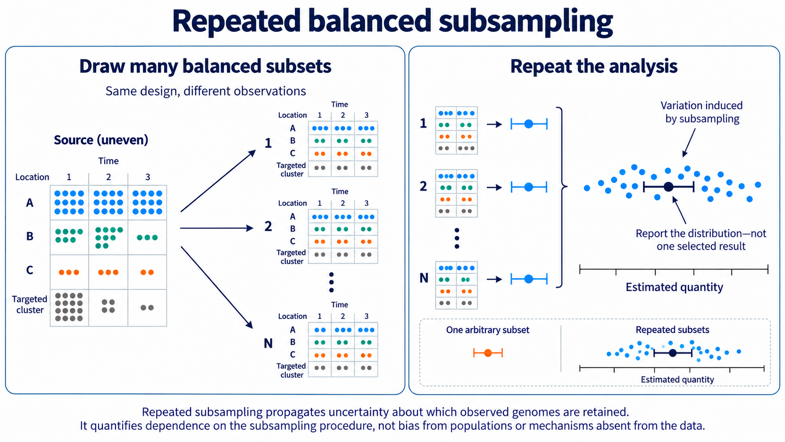
Figure 12
Repeated balanced subsampling
Repeated draws quantify dependence on which observed genomes are retained.
8
Notes:
Teaching message: Repeated draws quantify dependence on which observed genomes are retained.
Panel prompts:
- Apply the same design to many subsets.
- Repeat the same analysis for every subset.
- Report the distribution, not one arbitrary draw.

Slide 9
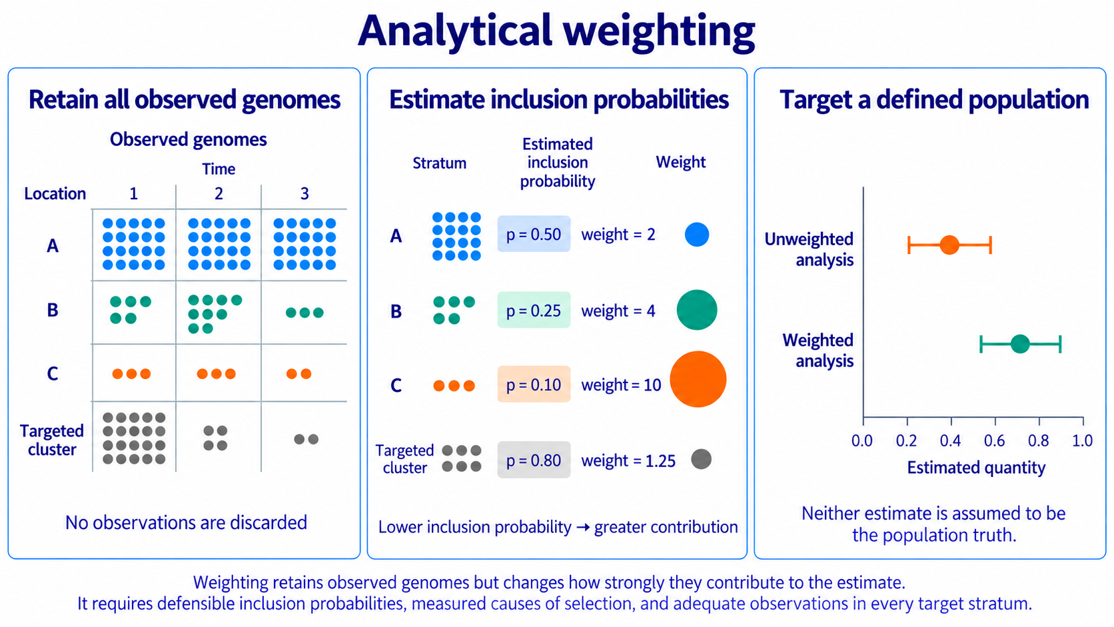
Figure 13A
Analytical weighting
Weighting retains observations but changes their contribution to a defined target.
9
Notes:
Teaching message: Weighting retains observations but changes their contribution to a defined target.
Panel prompts:
- Keep all observed genomes.
- Estimate inclusion probabilities and corresponding weights.
- Compare weighted and unweighted estimates without designating truth.

Slide 10
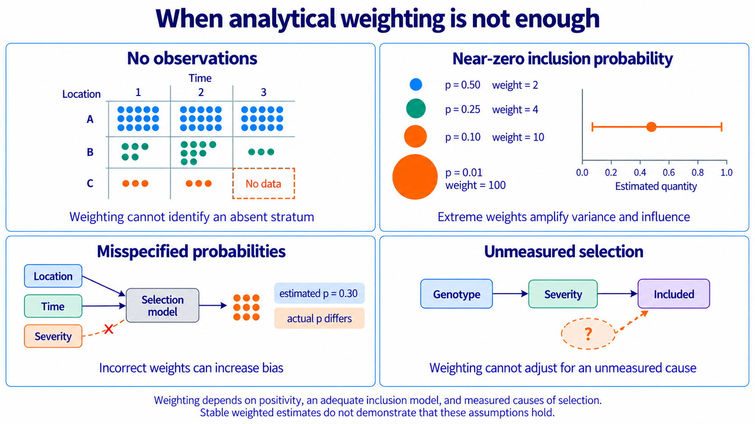
Figure 13B
When analytical weighting is not enough
Weighting depends on positivity, an adequate inclusion model, and measured causes of selection.
10
Notes:
Teaching message: Weighting depends on positivity, an adequate inclusion model, and measured causes of selection.
Panel prompts:
- Separate absent strata from near-zero inclusion probabilities.
- Show the consequences of extreme or misspecified weights.
- Identify selection determinants that remain unmeasured.

Slide 11
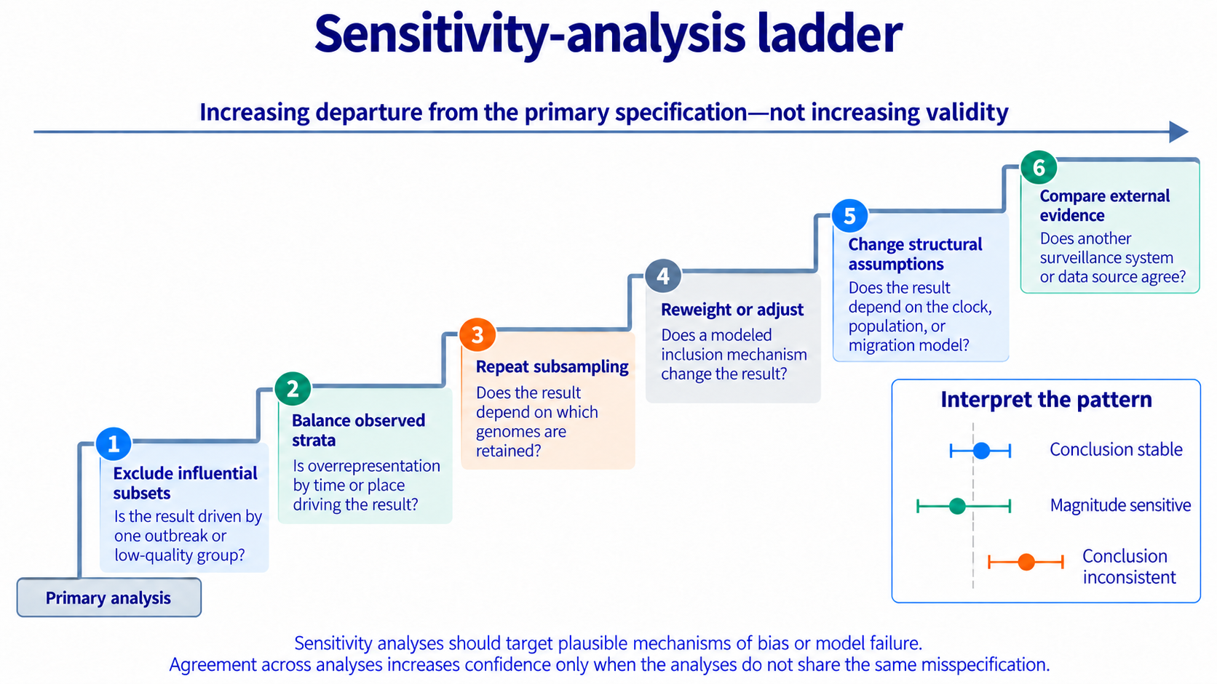
Figure 14
Sensitivity-analysis ladder
Sensitivity analyses should target plausible mechanisms of bias or model failure.
11
Notes:
Teaching message: Sensitivity analyses should target plausible mechanisms of bias or model failure.
Panel prompts:
- Move from simple exclusions to alternative models and external evidence.
- Increasing departure does not mean increasing validity.
- Classify conclusions as stable, magnitude sensitive, or inconsistent.

Slide 12
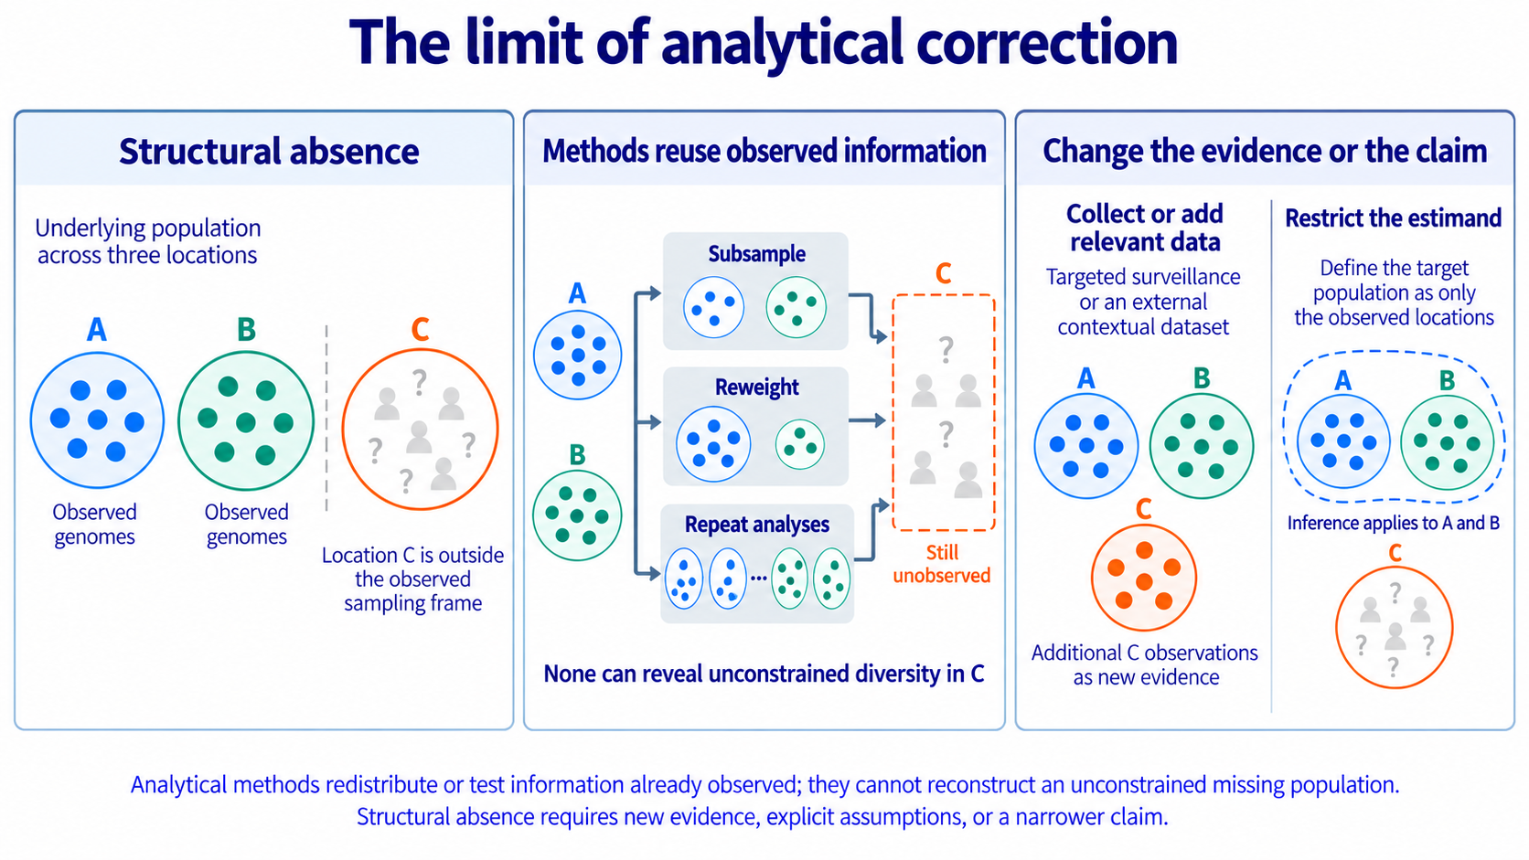
Figure 15
The limit of analytical correction
Methods cannot reconstruct an unconstrained population absent from the sampling frame.
12
Notes:
Teaching message: Methods cannot reconstruct an unconstrained population absent from the sampling frame.
Panel prompts:
- Identify structural absence.
- Show that analytical methods reuse observed information.
- Add relevant evidence or restrict the estimand.

Slide 13
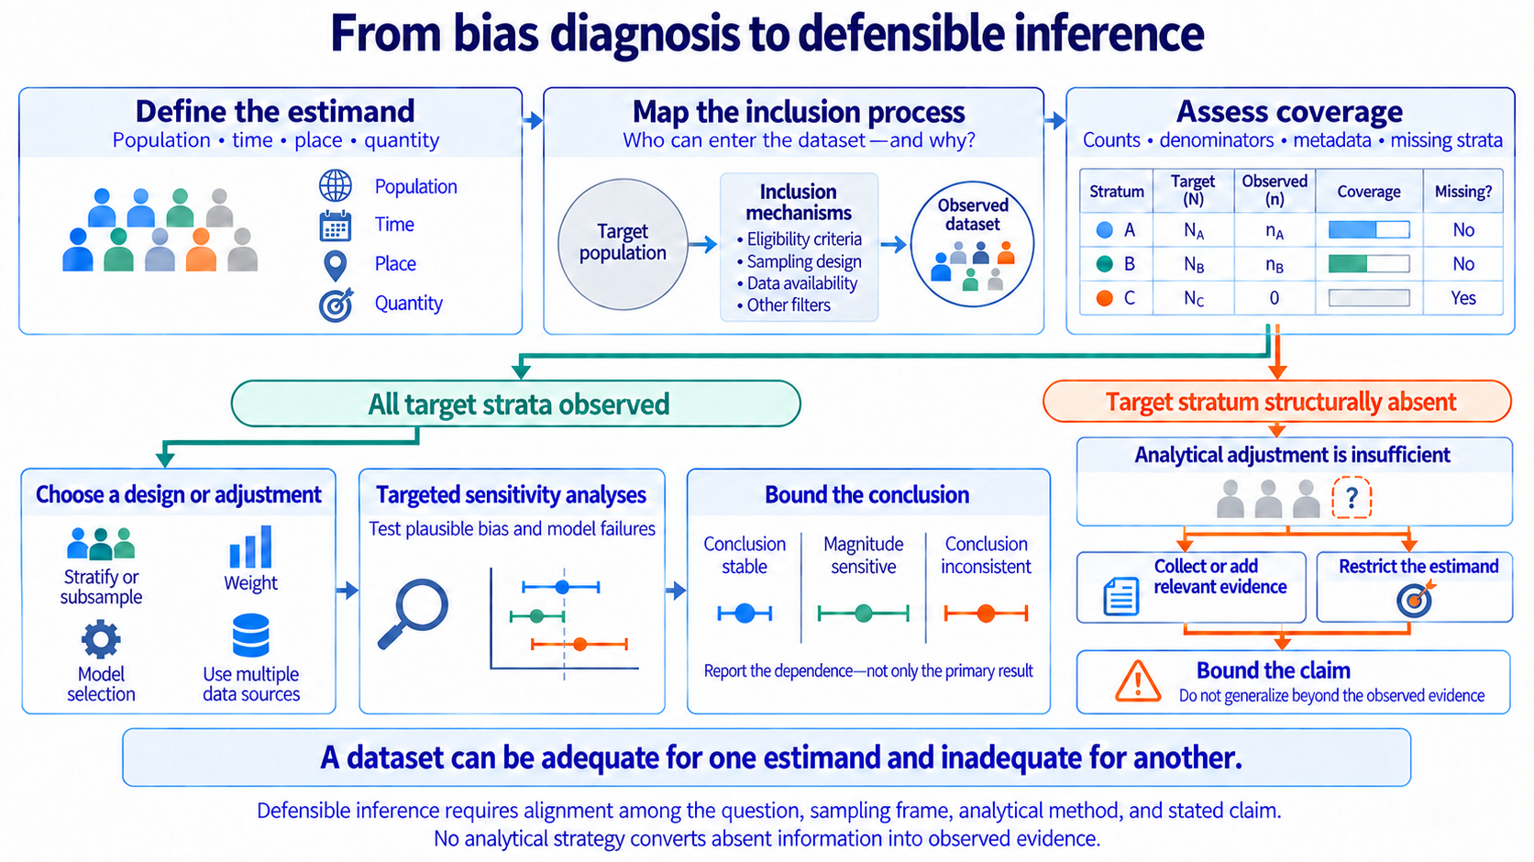
Figure 16
From bias diagnosis to defensible inference
Defensible inference aligns the estimand, inclusion process, coverage, analysis, and stated claim.
13
Notes:
Teaching message: Defensible inference aligns the estimand, inclusion process, coverage, analysis, and stated claim.
Panel prompts:
- Define the estimand, map inclusion, and assess coverage.
- Route observed target strata through adjustment and sensitivity analysis.
- Route structural absence toward new evidence or a narrower claim.

Slide 14
Key takeaways
Design and analysis must follow the estimand.
Subsampling, weighting, and sensitivity analysis answer different questions.
Structural absence requires new evidence, explicit assumptions, or a narrower claim.
Part III Designing Defensible Inference
Bias in Molecular Epidemiology: A story in three parts
14
Notes:
Closing takeaways:
- Design and analysis must follow the estimand.
- Subsampling, weighting, and sensitivity analysis answer different questions.
- Structural absence requires new evidence, explicit assumptions, or a narrower claim.

